Slide 1
Inverse Laplace Transform
Linear Circuit Analysis II
EECE 202 – Spring 2025

Slide 2
Announcement
Project Proposal released
Quiz next Week 4

Slide 3
Recap
Properties of Laplace transform
Laplace transform of sinusoidal signals
New Material
Inverse Laplace transform analysis
LT using partial fraction
Applications of LT

Slide 4
Laplace Transform Analysis
Circuit
Output Signal
Input Signal
LT of Input Signal
Laplace Transform (LT) of Circuit
LT of Output Signal

Slide 5
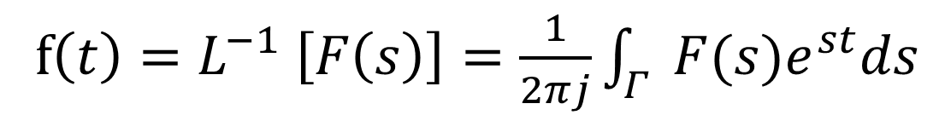
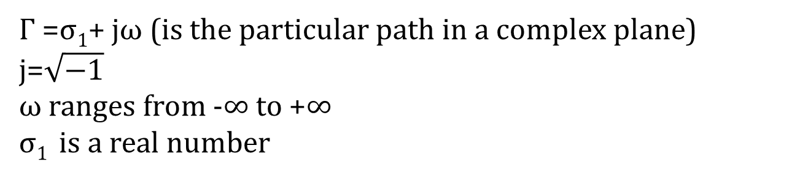
Inverse Laplace Transform
The inverse Laplace Transform of a Signal, a Function, or an Excitation is given by:
f$\left(t\right)=L^{−1} \left[F\left(s\right)\right]=\frac{1}{2πj}\int_{Γ}^{g}{F(s)e^{st}ds}$
$Γ$ =σ₁+ jω (is the particular path in a complex plane)
j=$\sqrt{−1}$
ω ranges from -∞ to +∞
σ₁ is a real number

Slide 6
Example 1
Determine the inverse Laplace transform of each of the following functions:
Answer
Can be also obtained by applying partial fraction!

Slide 7
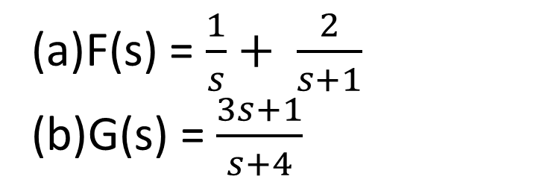
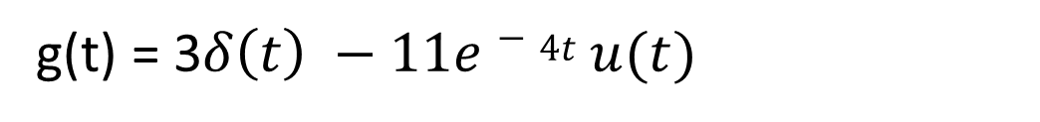
salman
Example 1
Determine the inverse Laplace transform of each of the following functions:
F(s) = $\frac{1}{s}+ \frac{2}{s+1}$
G(s) = $\frac{3s+1}{s+4}$
Answer
Can be also obtained by applying partial fraction!
(a) f(t) = u(t) + 2e^{-t} u(t)
(a) G(s) = $\frac{3\left(s+4\right)−11}{s+4}=3 − \frac{11}{s+4}$
g(t) = 3$δ\left(t\right) −11e−4t u(t)$

Slide 8

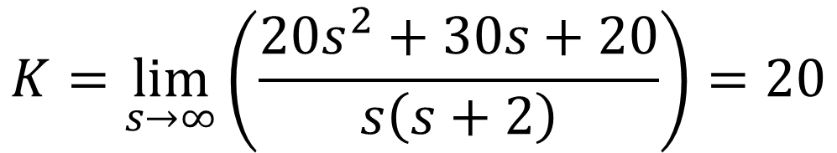
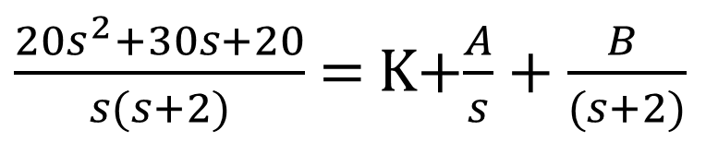
Example 2
Find f (t ) when F (s)= $\frac{{20s}^{2}+30s+20}{s(s+2)}$
$\frac{{20s}^{2}+30s+20}{s(s+2)}$ = K+$\frac{A}{s}+\frac{B }{(s+2)}$
Step 1. Use partial fraction
Step 2. Determine K.
$$K=\lim_{s→∞}\left(\frac{{20s}^{2}+30s+20}{s\left(s+2\right)}\right)=20$$
K = 20

Slide 9
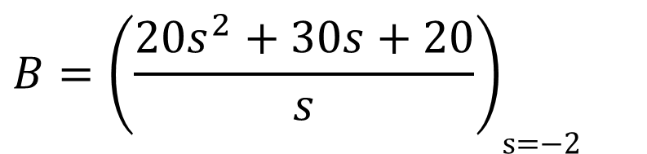
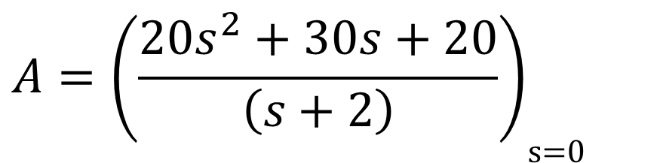
Step 3. Determine A
$$A={\left(\frac{{20s}^{2}+30s+20}{\left(s+2\right)}\right)}_{\text{s}\text{=0 }}$$
A = 10
Step 4. Determine B
$$B={\left(\frac{{20s}^{2}+30s+20}{s}\right)}_{\text{s}\text{=−2} }$$
B = -20

Slide 10
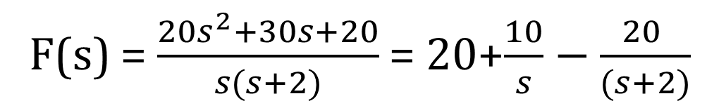
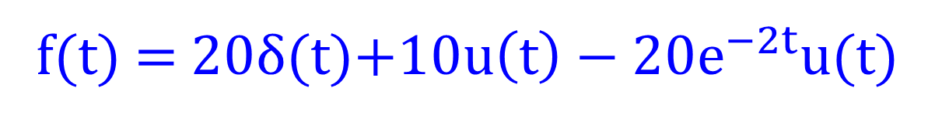
Step 5. Obtain f(t) from F(s) “apply inverse Laplace transform”
F(s) = $\frac{{20s}^{2}+30s+20}{s(s+2)}$ = 20+$\frac{10}{s}−\frac{20 }{(s+2)}$
f(t) = 20δ(t)+$10u\left(t\right)−20e^{−2t}u(t)$

Slide 11

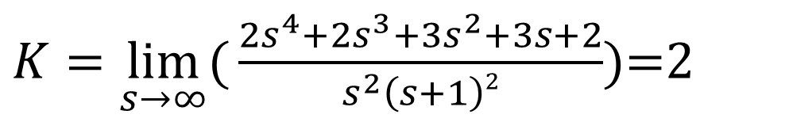
Exercise (p. 571)
Find f (t ) when F (s)= $\frac{{2s}^{4}+{2s}^{3}+{3s}^{2}+3s+2}{s^{2}\left(s+1\right)2}$
Step 1. Use partial fraction
$\frac{{2s}^{4}+{2s}^{3}+{3s}^{2}+3s+2}{s^{2}\left(s+1\right)2}$=K+$\frac{A}{s}+\frac{B}{s^{2}}+\frac{C}{(s+1)}+\frac{D}{{(s+1)}^{2}}$ Eq(1)
Step 2. Determine K.
$K=\lim_{s→∞}{(}\frac{{2s}^{4}+{2s}^{3}+{3s}^{2}+3s+2}{s^{2}\left(s+1\right)2}$)=2

Slide 12
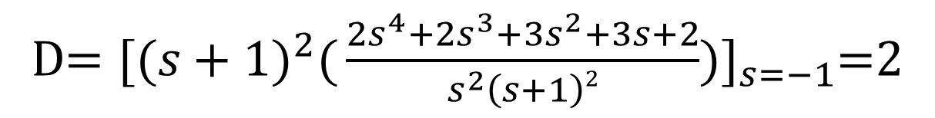
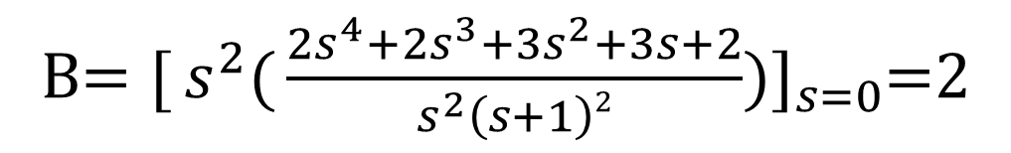
Step 3. Determine B
B$=[{s^{2}(}\frac{{2s}^{4}+{2s}^{3}+{3s}^{2}+3s+2}{s^{2}\left(s+1\right)2}$)$]_{s=0}$=2
Step 4. Determine D
D$=[{{(s+1)}^{2}(}\frac{{2s}^{4}+{2s}^{3}+{3s}^{2}+3s+2}{s^{2}\left(s+1\right)2}$)$]_{s=−1}$=2
Step 5. Determine A and C
We need to make 2 equations with 2 unknowns (A and C) using Eq(1)

Slide 13
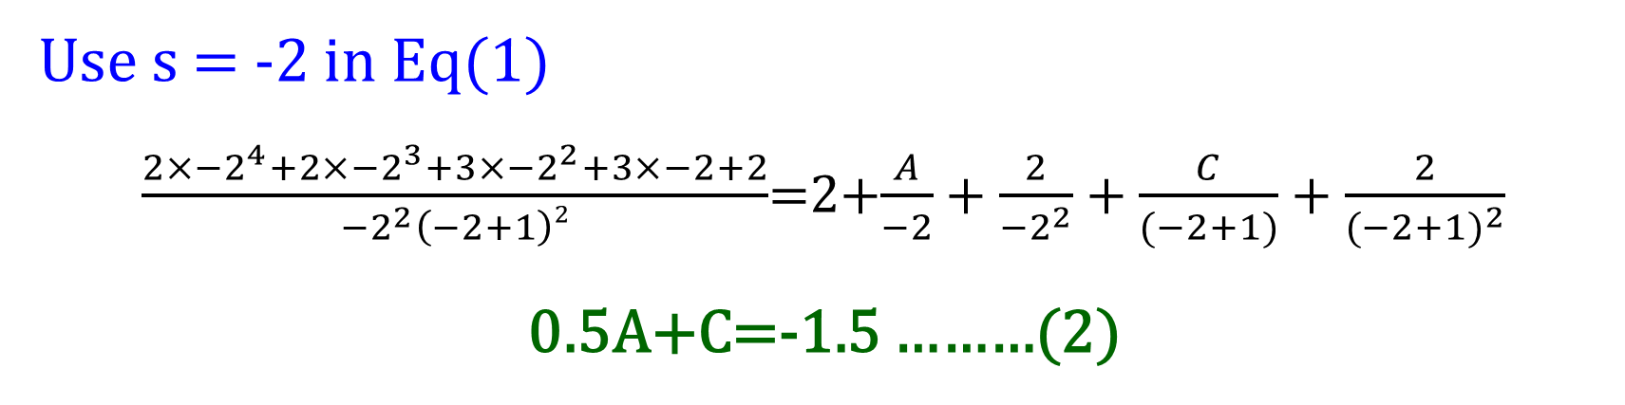
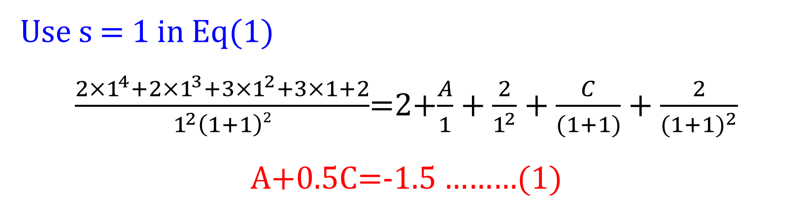
Use s = 1 in Eq(1)
$\frac{{2×1}^{4}+{2×1}^{3}+{3×1}^{2}+3×1+2}{1^{2}\left(1+1\right)2}$=2+$\frac{A}{1}+\frac{2}{1^{2}}+\frac{C}{(1+1)}+\frac{2}{{(1+1)}^{2}}$
A+0.5C=-1.5 ………(1)
Use s = -2 in Eq(1)
$\frac{{2×−2}^{4}+{2×−2}^{3}+{3×−2}^{2}+3×−2+2}{{−2}^{2}\left(−2+1\right)2}$=2+$\frac{A}{−2}+\frac{2}{{−2}^{2}}+\frac{C}{(−2+1)}+\frac{2}{{(−2+1)}^{2}}$
0.5A+C=-1.5 ………(2)
By solving both equations, A=-1 and C=-1

Slide 14
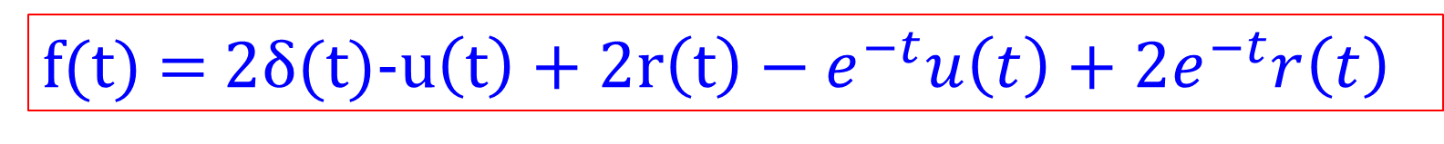
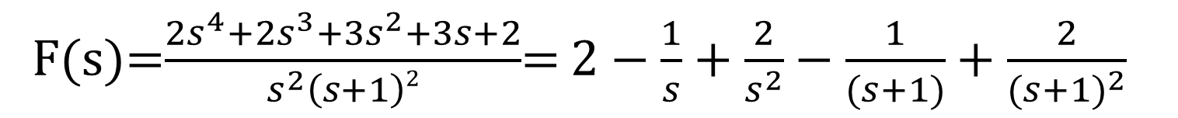
Step 6. Obtain f(t) from F(s) “apply inverse Laplace transform”
F(s)=$\frac{{2s}^{4}+{2s}^{3}+{3s}^{2}+3s+2}{s^{2}\left(s+1\right)2}$= $2−\frac{1}{s}+\frac{2}{s^{2}}−\frac{1}{(s+1)}+\frac{2}{{(s+1)}^{2}}$
f(t) = 2δ(t)-$u\left(t\right)+2r\left(t\right)−e^{−t}u\left(t\right)+2e^{−t}r\left(t\right)$

Slide 15

Reminder
Series Resistors and Voltage division
Ohm’s law:
+ -
+ -
+
_
and
KVL:
The equivalent resistance of any number of resistors connected in series is the sum of the individual resistances.

Slide 16


Reminder
Series Resistors and Voltage division
SALMAN
R_{eq} = R₁ + R₂
Ohm’s law:
+ -
+ -
+
_
V₁ =I R₁
and
V₂ =I R₂
KVL:
The equivalent resistance of any number of resistors connected in series is the sum of the individual resistances.
V_{S} = V₁ + V₂
V_{S} = IR₁ + IR₂
V_{S} = I(R₁ + R₂)
V_{S} = I(R_{eq})
V_{S} = I(R₁ + R₂)
I = $\frac{VS}{(R1+R2)}$
V₁ = IR₁ = $\frac{R1}{(R1+R2)} VS$
V₂ = IR₂ = $\frac{R2}{(R1+R2)} VS$

Slide 17
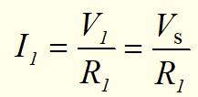
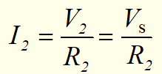





Reminder:
Parallel Resistors And Current Division
+
-
+
-
Ohm’s law:
&
KCL:
+
_
Substitute
NOTE: This equation is only valid for 2 resistors connected in parallel

Slide 18
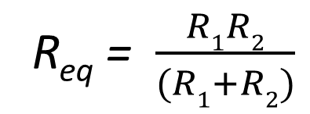
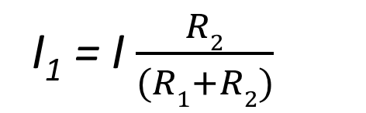
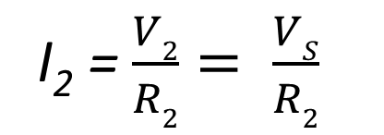
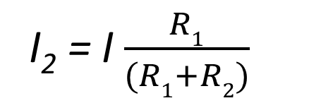
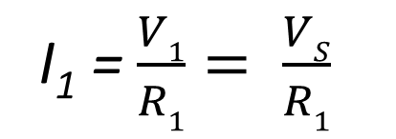
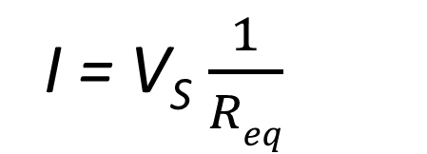
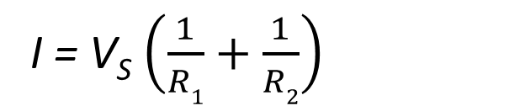
salman
Reminder:
Parallel Resistors And Current Division
+
-
+
-
Ohm’s law:
I₁ = $\frac{V1}{R1}= \frac{VS}{R1}$
&
I₂ = $\frac{V2}{R2}= \frac{VS}{R2}$
KCL:
I = I₁ + I₂
I = V_{S} $\left(\frac{1}{R1}+\frac{1}{R2}\right)$
I = V_{S}$\frac{1}{Req}$
+
_
V_{S} = IR_{eq}
Substitute
I₁ = I $\frac{R2}{(R1+R2)}$
I₂ = I $\frac{R1}{(R1+R2)}$
R_{eq} = $\frac{R1R2}{(R1+R2)}$
NOTE: This equation is only valid for 2 resistors connected in parallel

Slide 19
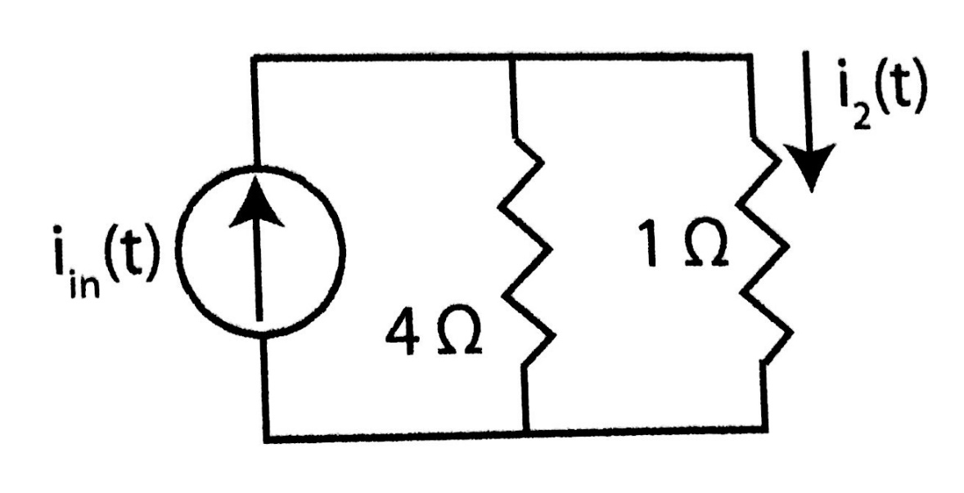
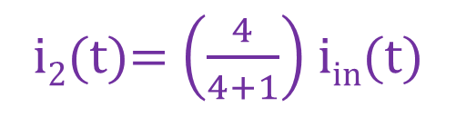
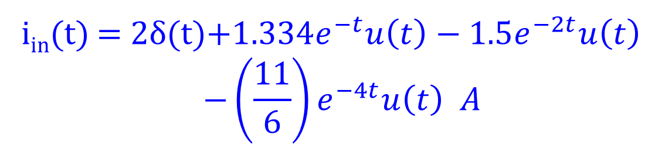
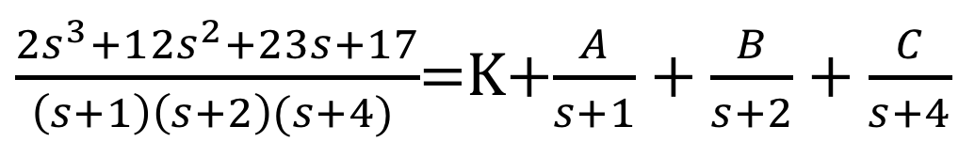
Circuit applications 1
Find i2(t) in the following circuit, where $I_{in}(s)=\frac{2s^{3}+12s^{2}+23s+17}{(s+1)(s+2)(s+4)}$
$\frac{{2s}^{3}+1{2s}^{2}+23s+17}{\left(s+1\right)\left(s+2\right)(s+4) }$=K+$\frac{A}{s+1}+\frac{B}{s+2}+\frac{C}{s+4}$
i₂(t)= $\left(\frac{4}{4+1}\right)$i_{in}(t)
K=2, A=4/3, B=-1.5, C=-11/6
i_{in}(t) = 2δ(t)$+1.334e^{−t}u\left(t\right)−1.5e^{−2t}u\left(t\right)$
$$−\left(\frac{11}{6}\right)e^{−4t}u\left(t\right) A$$

Slide 20
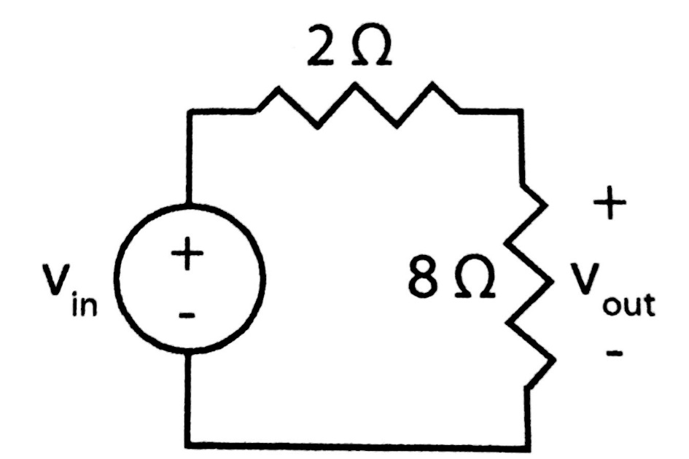
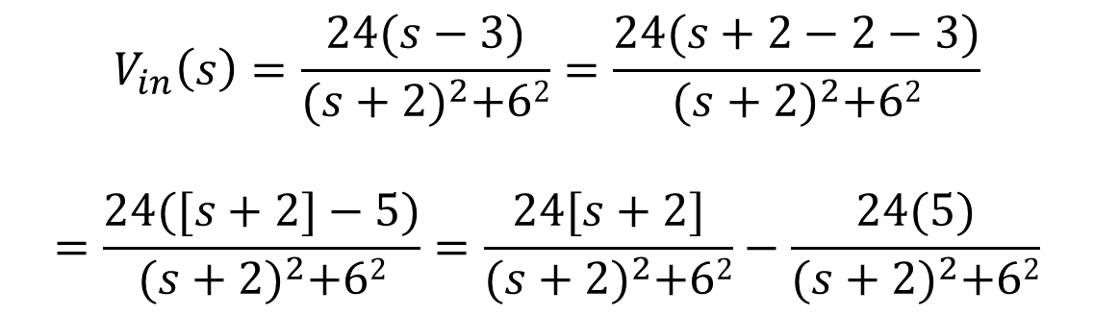


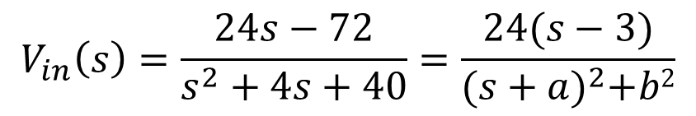
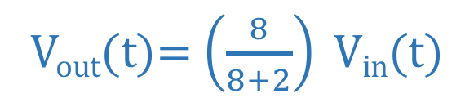
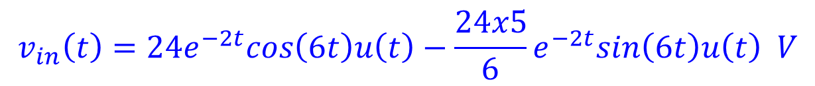
Circuit applications 2 (Ex. 12-13 page 567)
Find Vout(t) in the following circuit, where $V_{in}(s)=\frac{24s−72}{s^{2}+4s+40}$
$$V_{in}\left(s\right)=\frac{24s−72}{s^{2}+4s+40}=\frac{24(s−3)}{{(s+a)}^{2}+b2}$$
V_{out}(t)= $\left(\frac{8}{8+2}\right) Vin$(t)
$$s=−2±j6$$
$$a=2 , b=6$$
$$V_{in}\left(s\right)=\frac{24(s−3)}{{(s+2)}^{2}+62}=\frac{24(s+2−2−3)}{{(s+2)}^{2}+62}$$
$$=\frac{24([s+2]−5)}{{(s+2)}^{2}+62}=\frac{24[s+2]}{{(s+2)}^{2}+62}−\frac{24(5)}{{(s+2)}^{2}+62}$$
$$v_{in}\left(t\right)=24e^{−2t}cos\left(6t\right)u\left(t\right)−\frac{24x5}{6}e^{−2t}sin\left(6t\right)u\left(t\right) V$$

Slide 21
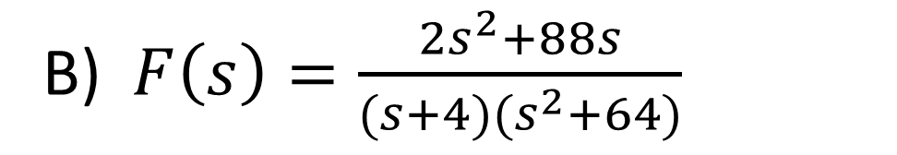
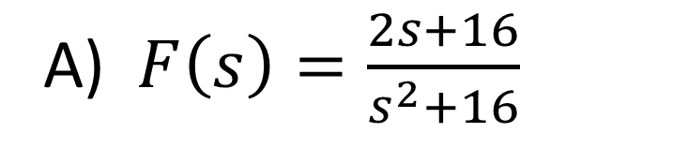
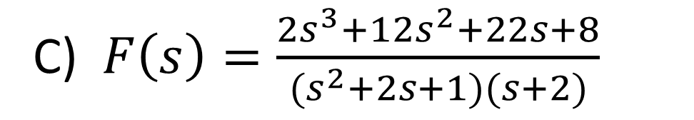
Practicing problems
Find f(t) of the following functions
A) $F\left(s\right)=\frac{2s+16}{s^{2}+16}$
B) $F\left(s\right)=\frac{2s^{2}+88s}{(s+4)(s^{2}+64)}$
C) $F\left(s\right)=\frac{2s^{3}+12s^{2}+22s+8}{(s^{2}+2s+1)(s+2)}$

Slide 22
Practice
Why is partial fraction decomposition useful in finding the inverse Laplace transform of complex rational functions?
Explain how the inverse Laplace transform helps in solving time-domain circuit problems from their s-domain equivalents.
How does transforming a function from the frequency domain (s-domain) to the time domain help in analyzing real-world signals and systems?
Solve activity on Moodle

Slide 23
Summary
Inverse Laplace Transform Basics
Converts a function from the s-domain back to the time domain.
Key Methods
Partial Fraction Decomposition : Used to break down complex rational functions to make inverse transformation easier.
Direct Inverse Laplace: Using standard Laplace pairs to convert back to time-domain functions.
Applications in Circuit Analysis
Helps analyze circuits with initial conditions and transient responses.
Used to solve differential equations in circuit systems
Suggested Additional Problems for Ch. 12:
Example 12.13 (p. 567), 12.15 (p. 570),
Exercises (p. 575) ?

